Slide 1

University Colleage Cork
Modelling Biological Neural Networks
Ananthakrishnan, Kai & Laurel

Slide 2

01
Background Context
02
Historical Models
Overview
03
Research Methods
04
Discussion
05
Conclusion

Slide 3
University Colleage Cork
1 Background Context
Kai

Slide 4
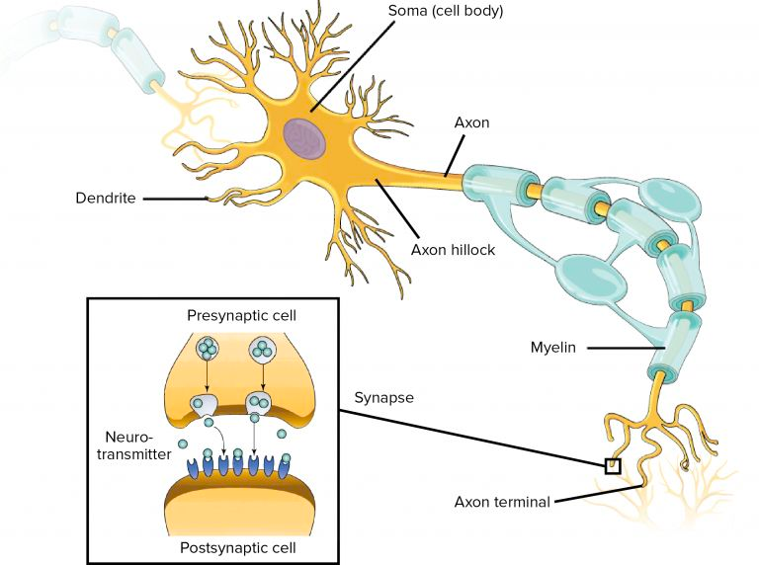
01
Anatomy Of A Neural
Neurons are cells — small bodies of mostly water, ions, amino acids and proteins with remarkable electrochemical properties. They are the primary functional units of the brain.
Soucre: Neurons and glial cells

Slide 5
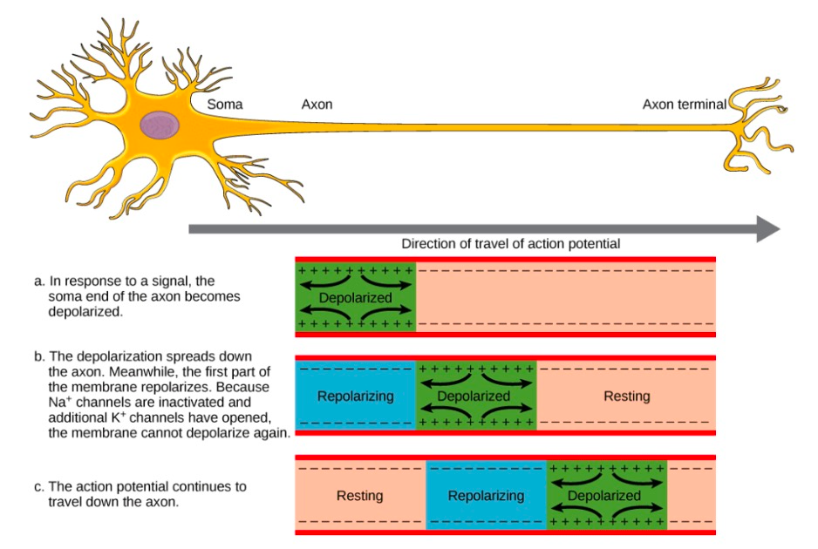
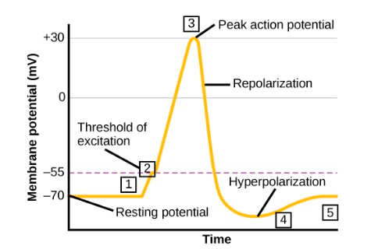
Physiology Of Neural
02
Neural impulses are rapid electrical signals that travel along neurons in the nervous system, facilitating physiological and behavioural responses to stimuli.
The transmission of a nerve impulse includes below stages:
Polarization, Depolarization, Repolarization
Refractory Period.
Soucre: Opentex

Slide 6
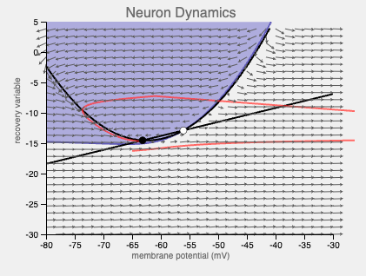
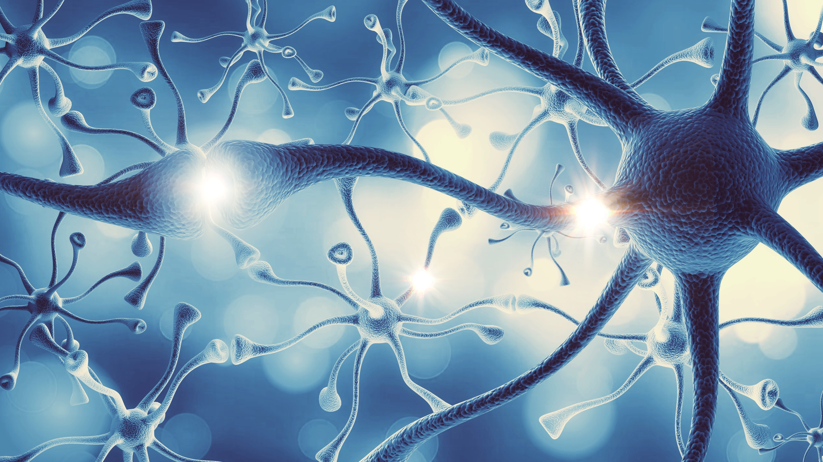
03
Biological Neural Networks
Biological neural networks are the complex systems of neurons and their connections in organisms, crucial for processing and transmitting information, enabling perception, decision-making, and behaviour.

Slide 7
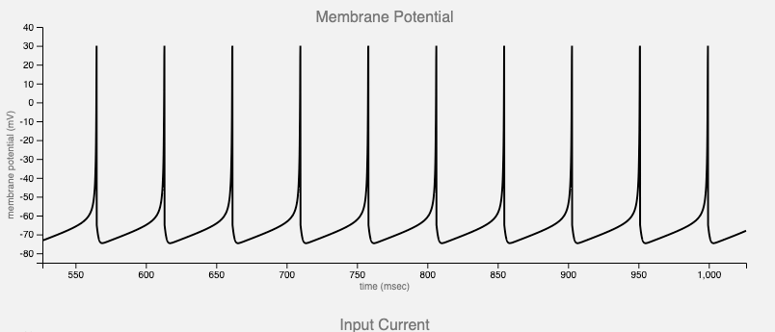
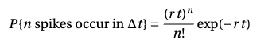
Spike Train
04
Spike trains are the language of neurons. People tend to think of spikes as point-events and spike trains as point-processe and assume spike trains are generated by random processes.
Soucre: Spiking Neurons

Slide 8
University Colleage Cork
2 Historical
Models
Kai

Slide 9
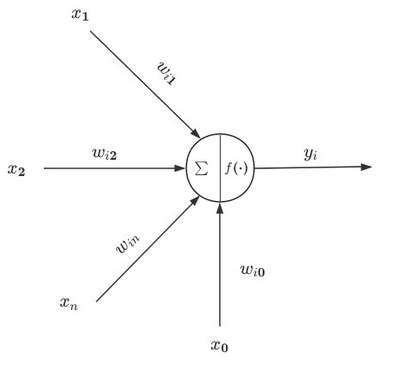
05
The M-P Model
The MP Neuron model, proposed by Warren McCulloch and Walter Pitts in 1943.
The MP Neuron model represents a binary threshold logic neuron, where inputs are binary (on/off) and weighted connections are summed. If the weighted sum exceeds a threshold, the neuron fires (outputs 1); otherwise, it does not fire (outputs 0) [1].

Slide 10
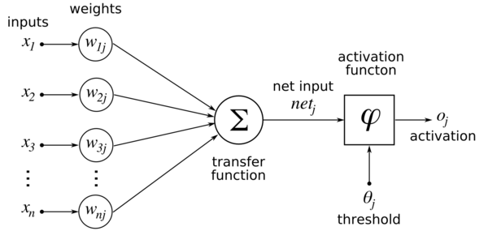
06
Hebb Learning rules
In 1949, Donald Hebbinan introduced a neural learning rule, that shows the connection strength between Neurons increases when one neuron's firing consistently precedes another', which means we can updates the connections or weights between neurons based on training samples.[2].
Soucre: Eyewire

Slide 11
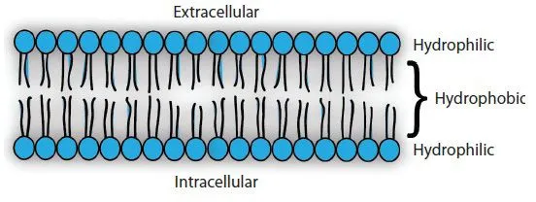
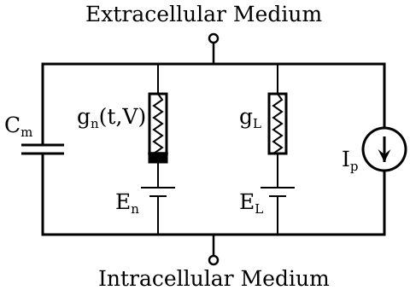
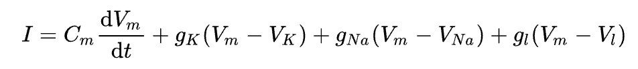
07
Hodgkin-Huxley Model
The Hodgkin–Huxley model, also known as the conductance-based model, was developed in 1952 by Alan Hodgkin and Andrew Huxley. This model, consisting of nonlinear differential equations, approximates the electrical behavior of excitable cells like neurons and muscle cells, providing a continuous-time dynamical system framework for understanding neural excitability and signaling[3].
Soucre: basicmedicalkey
Soucre: Wikipedia

Slide 12
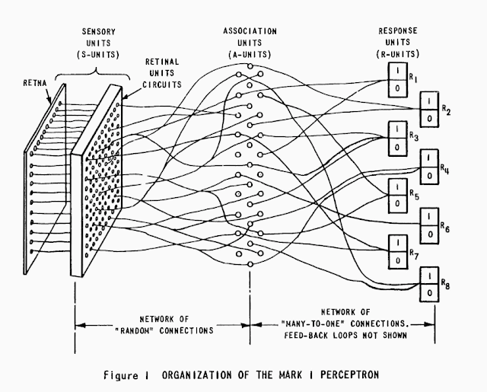
08
Mark I Perceptron
The Mark I Perceptron, developed by Frank Rosenblatt in 1957, was an early neural network model. It consisted of a single layer of neurons with binary threshold activation. The perceptron learned through a supervised learning algorithm, adjusting weights to minimize errors. Although successful for simple tasks, it had limitations, notably its inability to solve nonlinear problems. [4].
Soucre: Noema

Slide 13
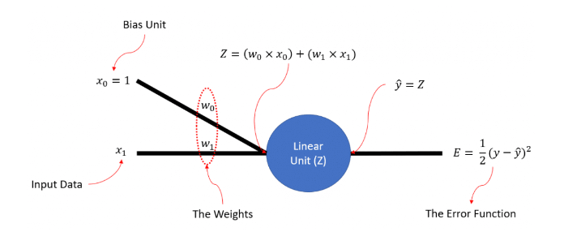
09
Delta Learning Rules
Common delta learning rule is a variant of the delta rule, called the delta rule or Widrow-Hoff rule(1960). This rule is based on the perceptron model and updates the weights based on the difference between the actual output and the desired output. The size of the update depends on the size of the input signal as well as the error signal[5].
Soucre: Mldawn

Slide 14
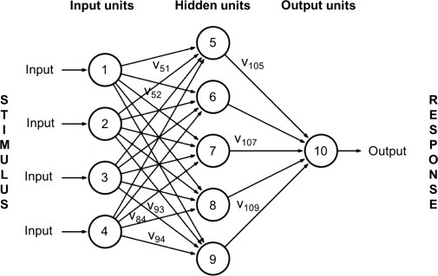
10
Hopfield Neural Network
The Hopfield neural network, proposed by John Hopfield in 1982, is a feedback-type neural network used for pattern recognition and optimization problem solving. This fully connected neural network with symmetric connection weights utilizes an energy function to describe the stability of network states and employs asynchronous update rules. It can store and recognize a set of patterns, achieved during the training phase by adjusting connection weights. The Hopfield neural network finds widespread applications in fields such as pattern recognition, optimization problem solving, and image processing[6].
Soucre: Science Direct

Slide 15
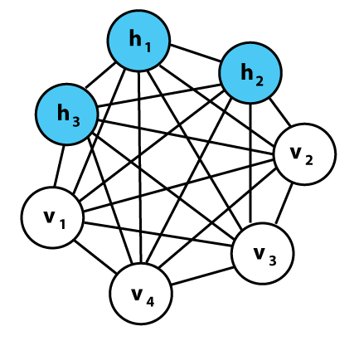
11
Boltzmann Machine
The Boltzmann Machine, introduced in 1985 by Geoffrey Hinton and Terry Sejnowski, is a stochastic recurrent neural network inspired by statistical mechanics. It consists of binary neurons with symmetric connections and utilizes an energy-based model. Learning is achieved through Contrastive Divergence. Boltzmann Machines are used for tasks like feature learning and generative modeling, contributing to advancements in machine learning[7].
Soucre: Wikipedia

Slide 16
01
Warren S Mcculloch and Walter Pitts. A LOGICAL CALCULUS OF THE DEAS IMMANENT IN NERVOUS ACTIVITY. September 1854.
02
D. O. Hebb. The Organization of Behavior: A Neuropsychological Theory. L. ErlbaumAssociates, Mahwah, N.J, 2002.
03
A. L. Hodgkin and Pitts A. F. Huxley. A quantitative description of membrane current and its application to conduction and excitation in nerve. August 1952.
Reference
04
F. Rosenblatt. The perceptron: A probabilistic model for information storage and organization in the brain. Psychological Review, 65(6):386–408, 1958.
05
Bernard Widrow and Marcian E. Hoff Jr. Adaptive Switching Circuits. 1960.
06
J J Hopfield. Neural networks and physical systems with emergent collective computational abilities. April 1982.
07
G. E. Hinton and T. J. Sejnowski. Learning andf Relearning in Boltzmann Machines. 1:282–317, 1986.

Slide 17


University Colleage Cork
Thank You

